Slide 1
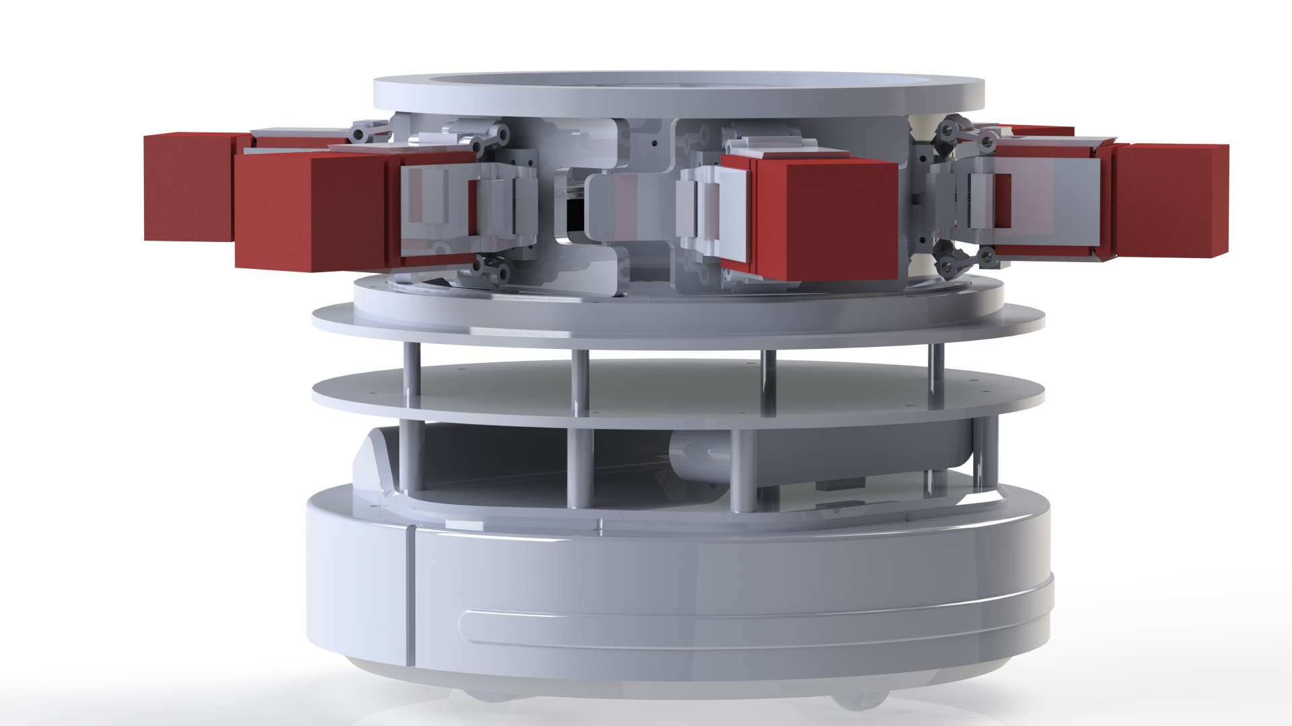
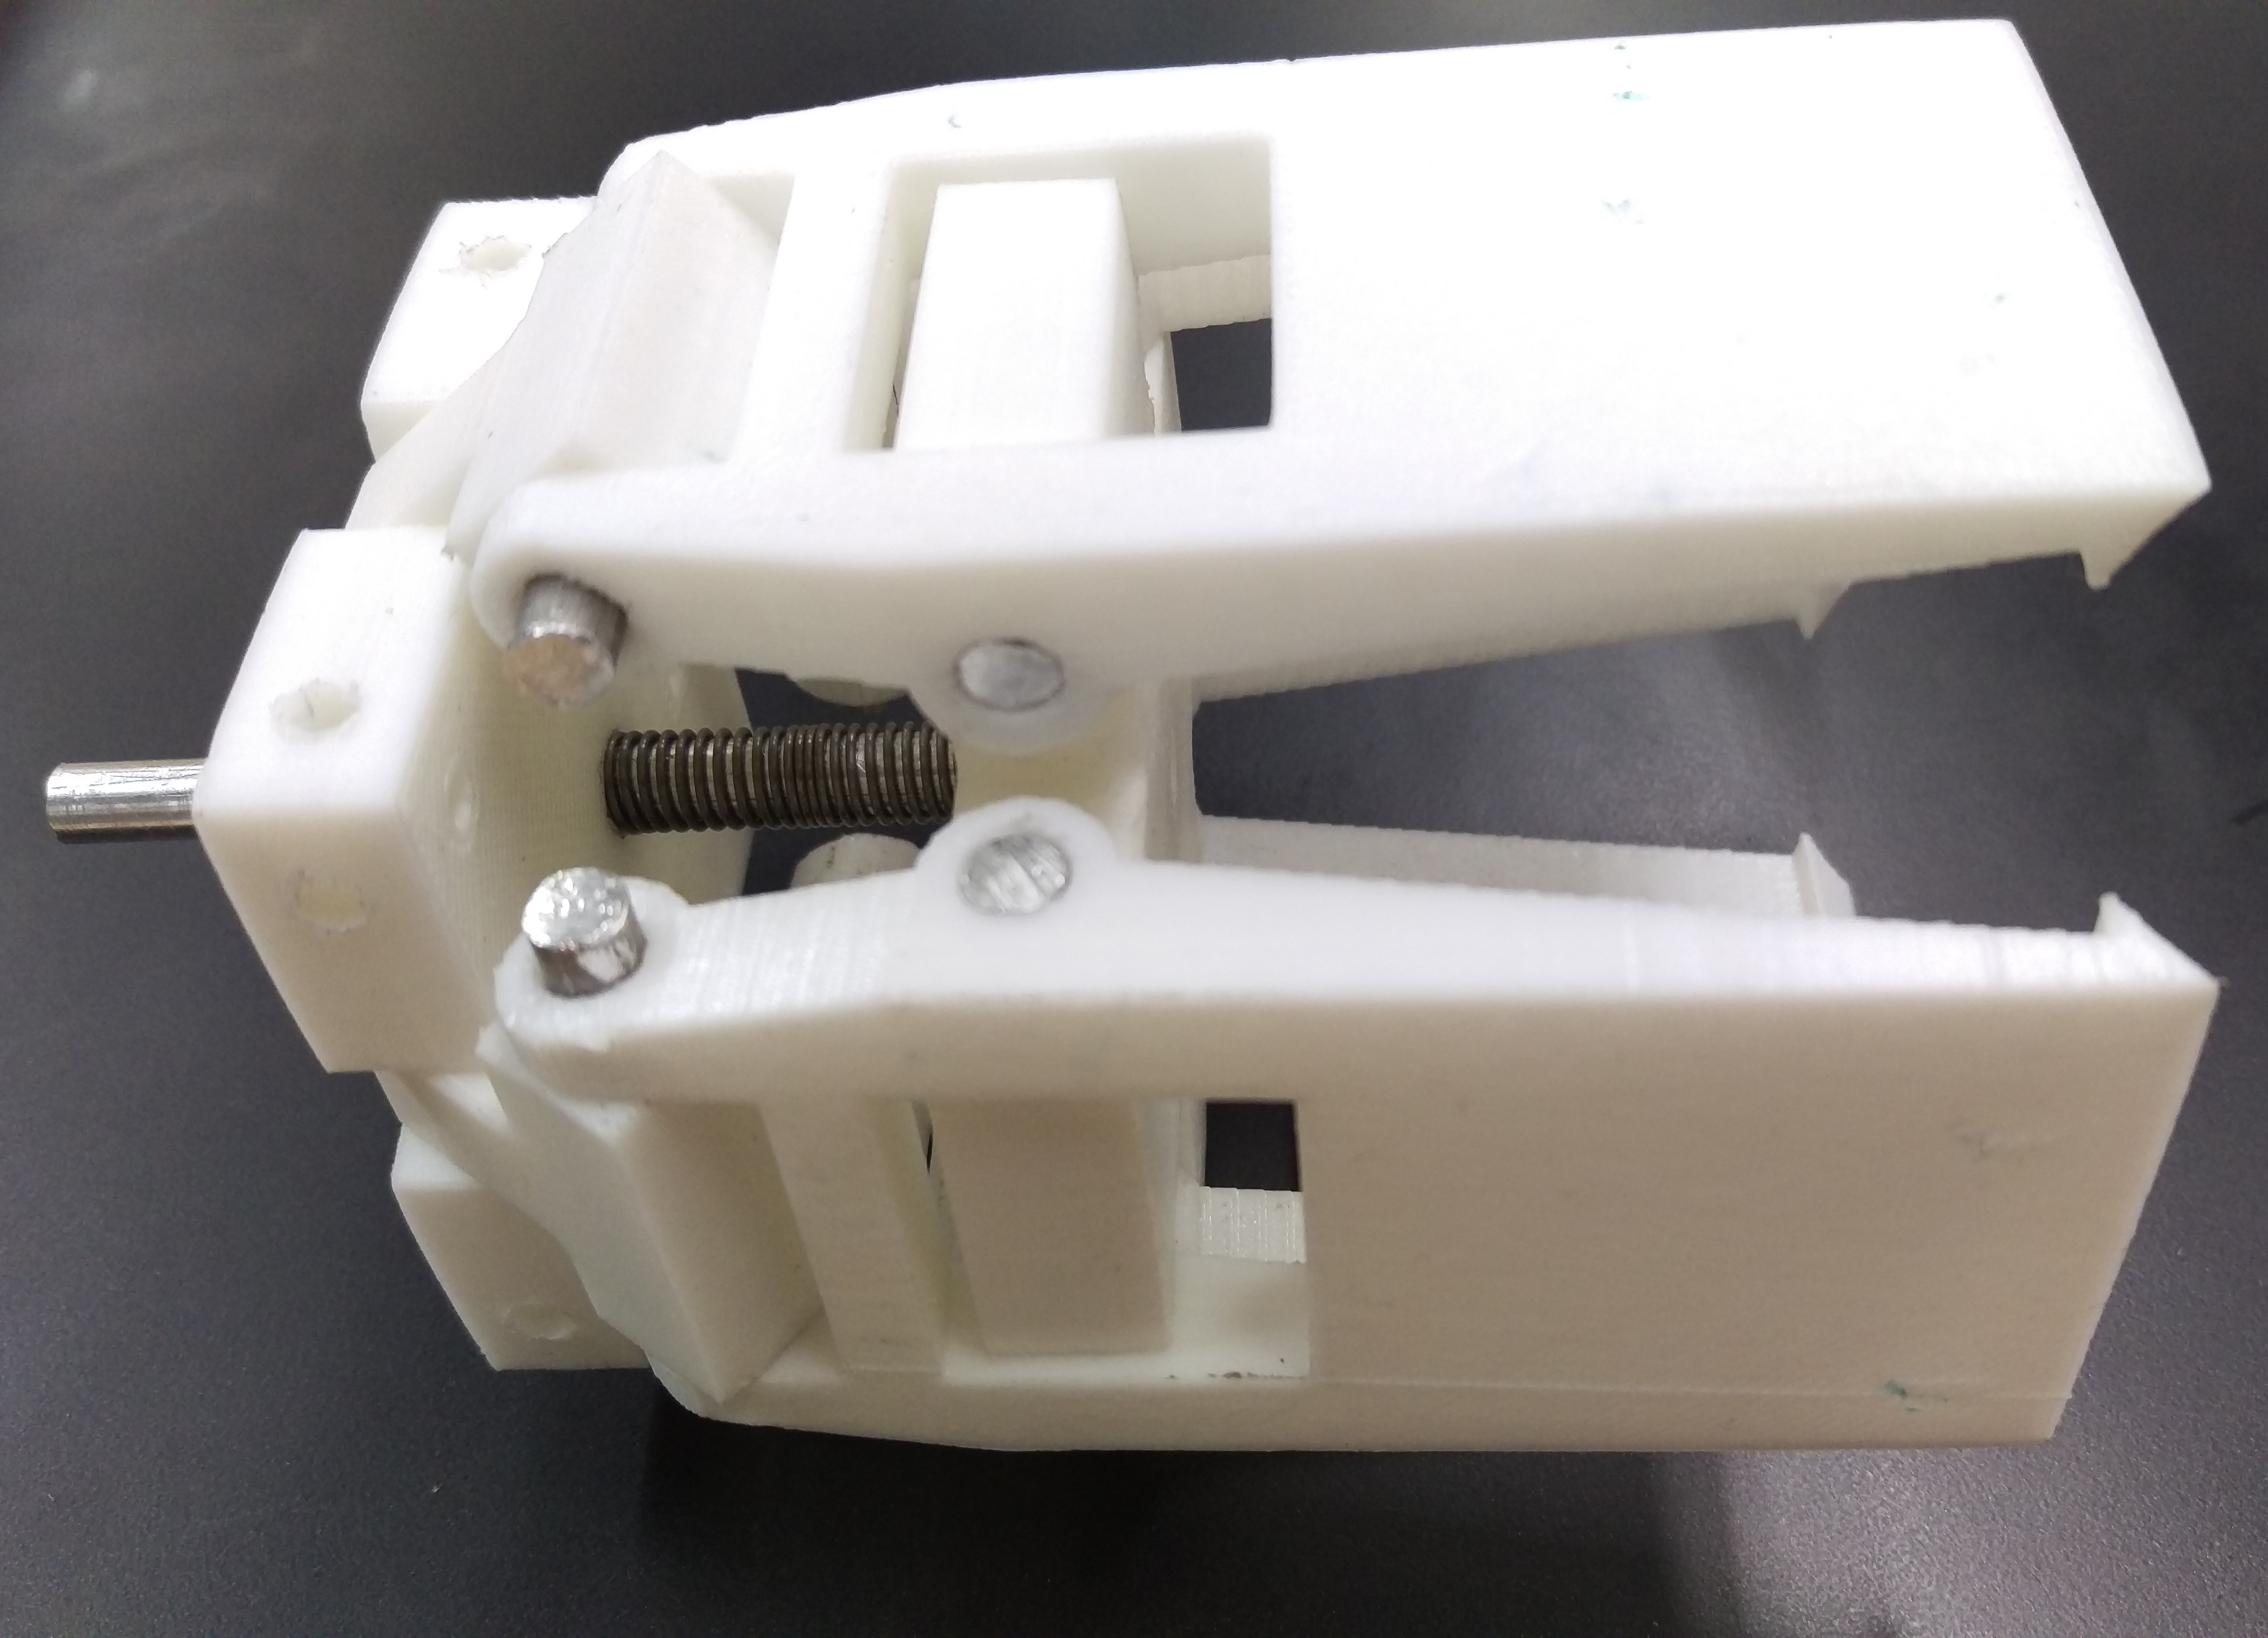
Minor robot logistics 2
Decentralized control
Remco Aarts, Jeroen van den Akker, Robert Delmaar, Bas Janssen, Addie Perenboom, Dimitri Waard
Introduction
This is a 14 week project form the minor Adaptive Robotics.
The goal project decentralized multi-robot logistics is to create the industry 4.0 by using Turtlebots to transport products.
In this project the Turtlebots are decentralized. That means that the robots decide who will pick up the products.
Figure 1 – The mechanical design.
Hardware
Decision tree
Morphological chart
Multiple specializations
Gripper
Carriage
Figure 2 – The gripper
Software
Simulations
Scales to more robots
Desision calculation
References (in APA style)
Nevin, A. (1990). The changing of teacher education special education. Teacher Education and Special Education: The Journal of the Teacher Education Division of the Council for Exceptional Children, 13(3-4), 147-148.
Simmons, B. (2015, January 9). The tale of two Flaccos. Retrieved from http://grantland.com/the-triangle/the-tale-of-two-flaccos/
Correspondence to: Robert Delmaar r.delmaar.student@student.fontys.nl

